Slide 1
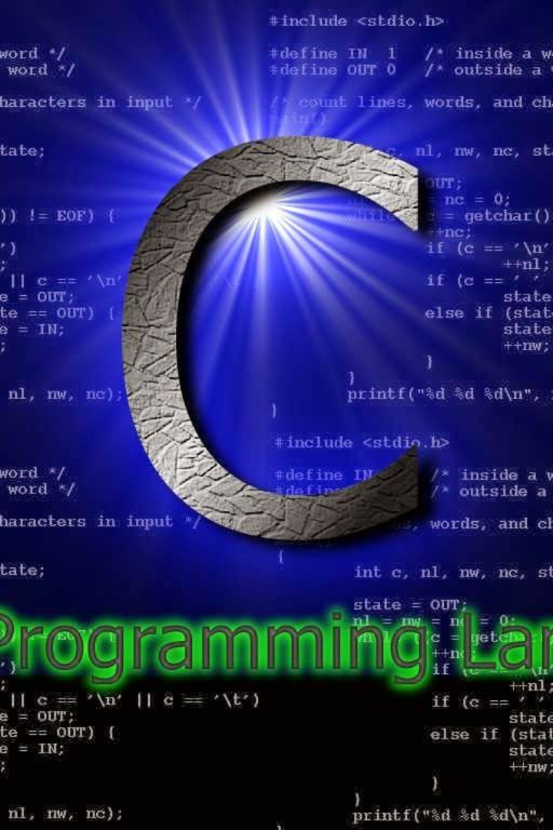
Types of Pointers
In the C programming language, pointers are powerful and versatile variables that store memory addresses. They are fundamental for tasks such as dynamic memory allocation, arrays, and data structures. Understanding pointers is crucial for mastering C programming. A pointer variable, declared using the asterisk (*) symbol, holds the address of another variable. This indirect way of accessing data allows for efficient manipulation and management of memory. Pointers play a key role in creating efficient and scalable code, making them a cornerstone of C programming.

Slide 2
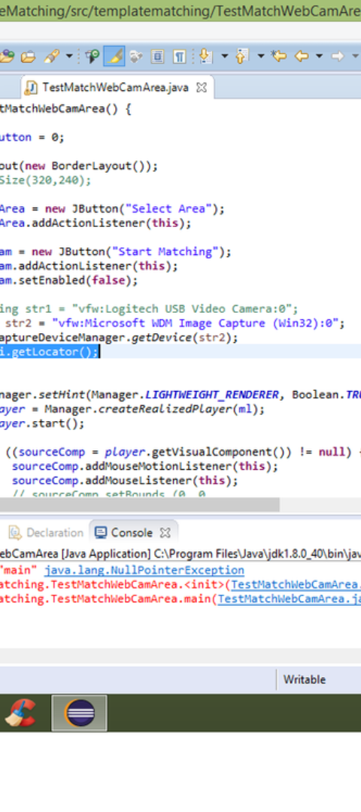
Null Pointer
Definition
Initializing a Null Pointer
A null pointer in C is a pointer that does not point to any memory location. It's represented by the value 0 or the macro NULL. Using a null pointer incorrectly can lead to unexpected behavior and program crashes.
To initialize a null pointer in C, you can simply assign the value of NULL to it. For example:
int *ptr = NULL;
This ensures that the pointer is explicitly pointing to nothing.
Common Pitfalls
One common mistake with null pointers is attempting to access or modify the memory location it points to. This can result in segmentation faults and other runtime errors. Proper handling of null pointers is crucial for writing robust and error-free C programs.

Slide 3

Example: Initializing a null pointer
Null Pointer: A null pointer is a pointer that does not point to any memory location. It's often used to initialize a pointer when the memory address is not yet known or to indicate that the pointer is intentionally not pointing to anything at the moment.
Initializing: Initializing a null pointer involves assigning the value NULL to the pointer. In C, the keyword NULL represents a null pointer constant, typically defined as 0.
Importance: Proper initialization of pointers, especially when they are not yet intended to point to a valid memory location, helps prevent unexpected behaviors and errors in the program.

Slide 4
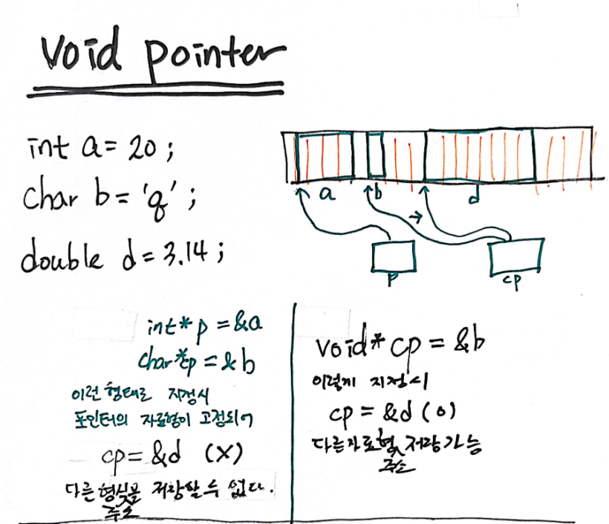
Void pointer
In C programming, a void pointer is a pointer that has no specific data type associated with it. It is used to hold the address of any data type, and its usage is commonly seen in functions that deal with memory allocation and deallocation.
One of the key uses of a void pointer is to allocate memory for a block of data without specifying the data type at the time of allocation. This provides flexibility in handling different types of data using the same allocation function.
It's important to note that since a void pointer has no data type associated with it, dereferencing a void pointer requires explicit type casting to the appropriate data type before accessing the value it points to.

Slide 5
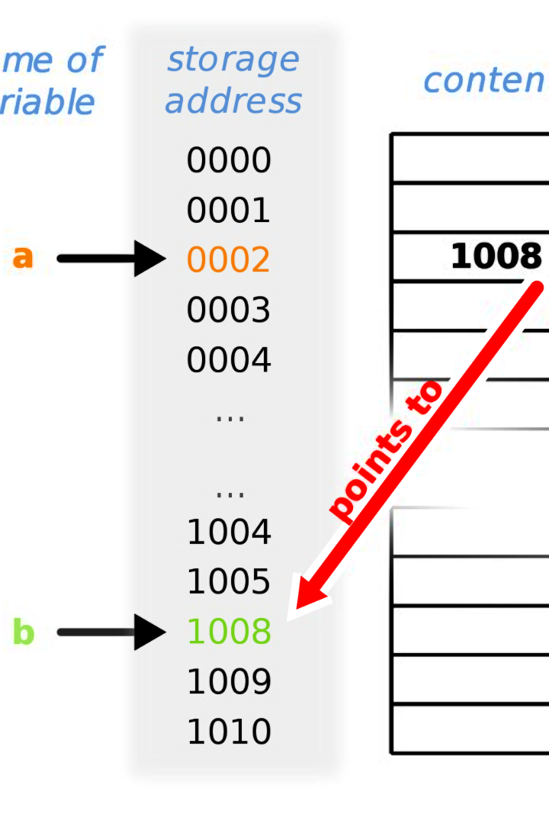
Example: Using a void pointer
When using a void pointer, it allows for the storage of any data type.
Because of its flexibility, void pointers are commonly used in low-level programming and functions that need to work with different data types.
One of the common uses of a void pointer is in dynamically allocating memory which is then typecast to different data types as needed.

Slide 6



Wild Pointer
Lost in the Wilderness
Unpredictable Behavior
Caution Required
A wild pointer in C programming is an uninitialized pointer or a pointer that points to a memory location that is no longer in use. It's like being lost in the jungle with no clear path to follow.
When a program accesses the value of a wild pointer, it can lead to unpredictable behavior, crashes, or security vulnerabilities. It's like trying to find your way without a map or compass.
Developers need to be extremely cautious when working with pointers to avoid creating wild pointers. It's like navigating through a dangerous wilderness where a misstep can have serious consequences.

Slide 7
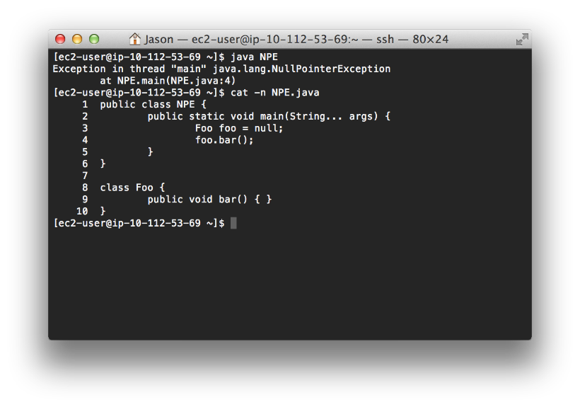
Example: Accessing a wild pointer
Accessing a wild pointer refers to the act of dereferencing an uninitialized pointer, which can lead to unpredictable behavior in a program. Wild pointers typically point to a memory location that hasn't been allocated, or they have been deallocated but not updated to NULL. When a wild pointer is accessed, it may lead to a segmentation fault, causing the program to crash. It can also result in the overwriting of unintended memory, potentially leading to data corruption or security vulnerabilities.

Slide 8
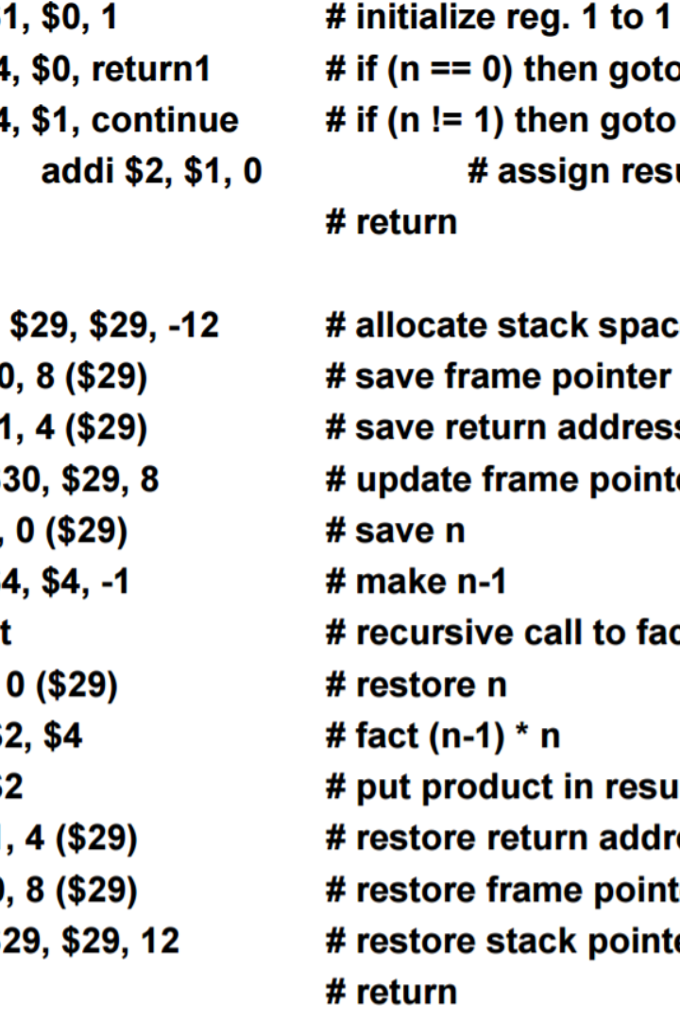
Function pointer
1
Function Address
2
Flexible Callback Mechanism
A function pointer stores the address of a function. It allows functions to be passed as arguments to other functions or used as return values.
Function pointers are essential for implementing callback mechanisms, where a function can call another function through a pointer, allowing for flexibility in program execution.
3
Dynamic Function Binding
They enable dynamic function binding, empowering the program to invoke functions at runtime based on specific conditions or user inputs.

Slide 9
Function pointer
Declaration
Usage
Example
In C, a function pointer is a pointer that points to the address of a function. It is used to call a function indirectly, and it enables the implementation of features like callbacks and dynamic function invocation. To declare a function pointer, you specify the return type of the function it points to, the name of the pointer, and the parameters of the function. For example, a function pointer that points to a function taking an integer parameter and returning void would be declared as:
Once a function pointer is declared, you can assign it the address of a compatible function. This allows for the dynamic invocation of functions based on different conditions or user input. For example, you can have an array of function pointers and use a loop to call different functions based on the elements of the array. Function pointers are particularly useful in implementing event handling, polymorphism, and other advanced programming techniques.
Suppose we have a function named 'printMessage' that takes a string as an argument and prints it. We can declare a function pointer 'void (*ptr)(char*)' and then assign it the address of 'printMessage'. Later, we can call the function indirectly using the function pointer:
ptr("Hello, World!");
This would result in the same behavior as calling 'printMessage("Hello, World!");' directly.
void (*ptr)(int);
This declares a function pointer named 'ptr'.

Slide 10

Pointer to pointer
1
Step 1: Declaring a pointer to a pointer
In C, a pointer to a pointer is a variable that stores the address of another pointer. It is denoted by using two (*) in the declaration. For example, int **ptr;
2
Step 2: Allocating memory for a pointer to pointer
When working with a pointer to a pointer, memory allocation is done in two steps. First, memory is allocated for the pointer to the pointer, and then memory is allocated for the pointer it points to. This is commonly used in two-dimensional arrays.
3
Step 3: Accessing the value using a pointer to pointer
To access the value pointed by a pointer to pointer, the dereference operator (**ptr) is used to obtain the value stored at the address pointed by the second pointer.

Slide 11

Example: Declaring and Using a Pointer to Pointer
In C programming, a pointer to pointer (or double pointer) is a variable that stores the memory address of another pointer. It allows for indirect access to data and is commonly used in scenarios that require multiple levels of indirection. By understanding how to declare and use a pointer to pointer, you can efficiently manipulate and manage complex data structures in your C programs.

Slide 12

Dangling Pointer
In C programming, a dangling pointer is a pointer that points to a memory location that has been freed or deallocated. Using a dangling pointer can lead to unpredictable behavior and program crashes. Avoid accessing or dereferencing a dangling pointer to ensure the stability and reliability of your program.
Example:
int *ptr = malloc(sizeof(int));
free(ptr);
*ptr = 10; // Dangling pointer

Slide 13

Summary of Pointer Concepts
In this presentation, we covered various pointer concepts in C programming. We discussed null pointers, void pointers, wild pointers, function pointers, pointers to pointers, and dangling pointers . Each concept has its own purpose and considerations. Proper understanding and usage of pointers can lead to efficient and effective programming.

